Slide 1
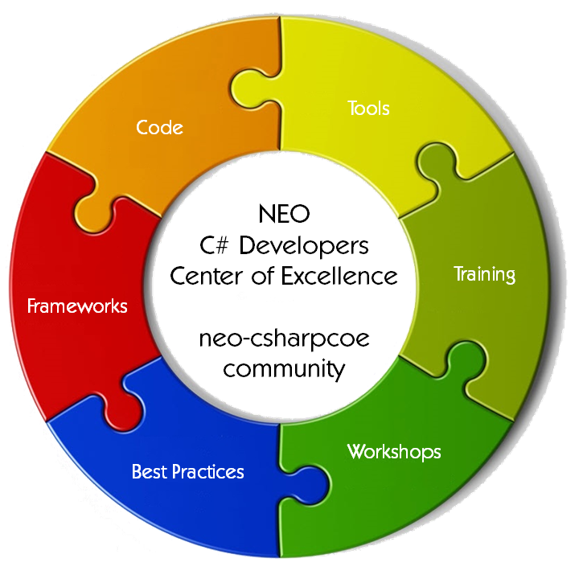
The NEO Smart Economy, Smart Processes, and Smart Data
Michael Herman
Independent Blockchain Developer
neotoronto@outlook.com
NEO C# Developers Center of Excellence
https://github.com/mwherman2000/neo-csharpcoe

Slide 2
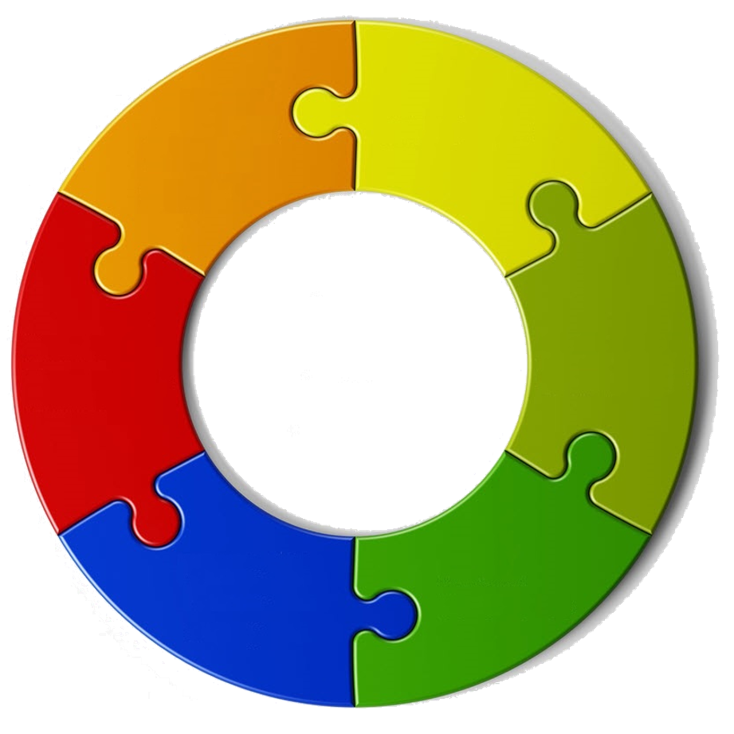
Sponsored by
Tools
Code
NEO
C# Developers
Center of Excellence
neo-csharpcoe
community
Training
Frameworks
Workshops
Best Practices

Slide 3



What is the NEO Smart Economy?
Digital Assets
+
NEO
Smart Economy
Smart Contracts
+
Digital Identity
“The NEO Smart Economy is about the world where the boundaries between real assets in the physical world and digital assets in the digital world have been removed.” [Malcolm Lerider, March 2018]

Slide 4
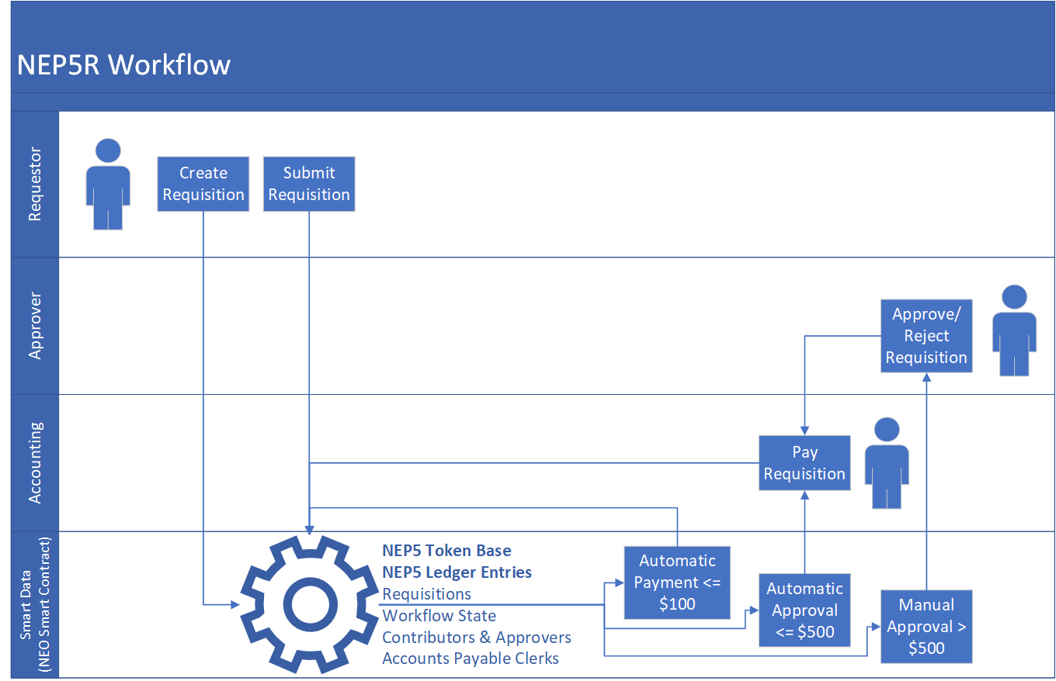
Think Deeply about the NEO Smart Economy
Today
But what people and businesses need is…
Tomorrow
1. create & submit
transfer
ATrzHaicmhRj15C3Vv6e6gLfLqhSD2PtTr
AK2nJJpJr6o664CWJKi1QRXjqeic2zRp8y
AZ9Bmz6qmboZ4ry1z8p2KF3ftyA2ckJAy
ATrzHaicmhRj15C3Vv6e6gLfLqhSD2PtTr
AK2nJJpJr6o664CWJKi1QRXjqeic2zRp8y
AZ9Bmz6qmboZ4ry1z8p2KF3ftyA2ckJAy
NEP5 (ERC20)
Tokens
NEP5R
Proposal
1. create & submit
2. approve/reject/reroute
transfer
transfer
3. pay
3. pay
2. approve/reject/reroute
Smart
Data

Slide 5
Smart Processes in the Smart Economy
Use Cases
Expense Reports
Timesheets
Contribution Reports
Lottery Tickets
Loyalty Points
Discount Coupons
Vouchers
Stock Certificates
Disbursements
…
AZ9Bmz6qmboZ4ry1z8p2KF3ftyA2ckJAy
ATrzHaicmhRj15C3Vv6e6gLfLqhSD2PtTr
1. create & submit
AK2nJJpJr6o664CWJKi1QRXjqeic2zRp8y
3. pay
2. approve/reject/reroute
Smart
Data

Slide 6
Smart Data = Smart Contract + Non-Fungible Entities
create
Smart Contract
NEP5*
NEP5 Token Base
NEP5 Ledger Entry
Requisition
Contributor
Approver Role
Accounts Payable Role
Public/Private App Keys
Workflow State
User Credential
Counter
submit
get
Non-Fungible Entities
Smart
Data
approve
register
reject
pay
reroute
* NEP5-defined operations

Slide 7
What is a non-fungible token? https://github.com/Splyse/neo-nft-template [https://hashpuppi.es/]
Joe Stewart @ Splyse…
A non-fungible token (NFT) can be thought of like a property deed - each one is unique and carries some non-mutable information (e.g. the physical address of the property) although other information, such as the owner of the property can be changed.
An NFT smart contract is useful to track ownership of real-world items, as well as in online gaming, allowing users to possess unique characters or items of a limited supply, that can be transferred between users without requiring the permission of the game owner.

Slide 8
What is a Non-fungible Entity?
Any persistable entity that has one or more read-only properties (fields) that cannot be changed once the entity has been created.
Examples
Expense Reports
Timesheets
Contribution Reports
Lottery Tickets
Loyalty Points
Discount Coupons
Vouchers
Stock Certificates
Disbursements
Money orders
The most common document lifecycle management scenarios include expense report and absence report submission where a document is submitted to a workflow involving roles, such as the manager role, which approve the content before it flows to another system. [Workflow, Tomorrow's Application Logic, InformIT]

Slide 9
Case Study: Recent Enterprise Workflow Assessment
After a recent enterprise Nintex audit and analysis of 70 workflows
55 of the workflows were found to be simple routing and approval workflows
15 of the workflows had more than 5 actions representing more complex scenarios
This met the typical expectation that 80/20% of most of workflows are simple routing and approval vs. more complex scenarios
“In a typical enterprise 80% or more forms and document workflows are simple routing and approval workflows.” [Joel Oleson, SharePoint Architect]

Slide 10
When to use Blockchain Technology “Blockchain: the force multiplier for the smart economy” [Microsoft]
Questions to Ask
Use a Blockchain when there is a Need for
Is it a business process that crosses trust boundaries?
Do multiple parties manipulate the same data?
Are processes operating inefficiently or decisions delayed due to the number of intermediaries?
Does the business process involve low-value, manual verification steps?
Real-time transparency by connecting business processes across organizations
Real-time, transparent access to a verifiable source of the truth across organization boundaries
Introduce trust and increase efficiency amongst participants - reducing the need for intermediaries
Improved efficiencies and increased confidence through automation enabled by smart contracts that execute consistently and reliably
“Use blockchain technology when it matches the requirements of your application. Don’t automatically use blockchain technology simply because you’re re-platforming an existing application.” [Gartner 2018]

Slide 11
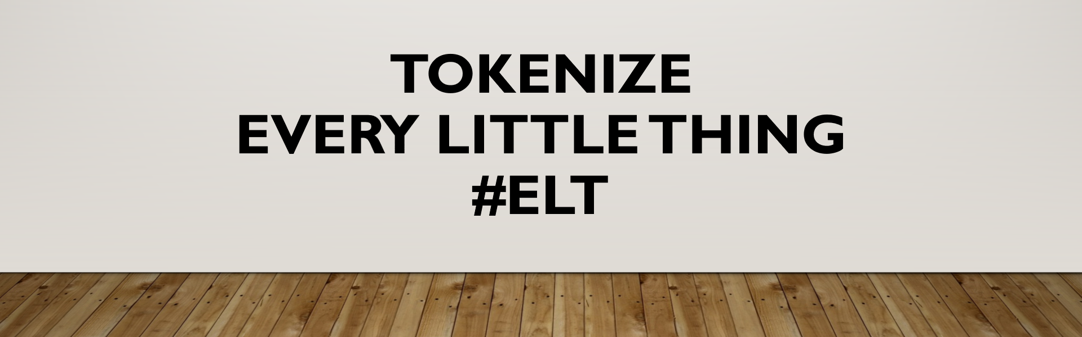
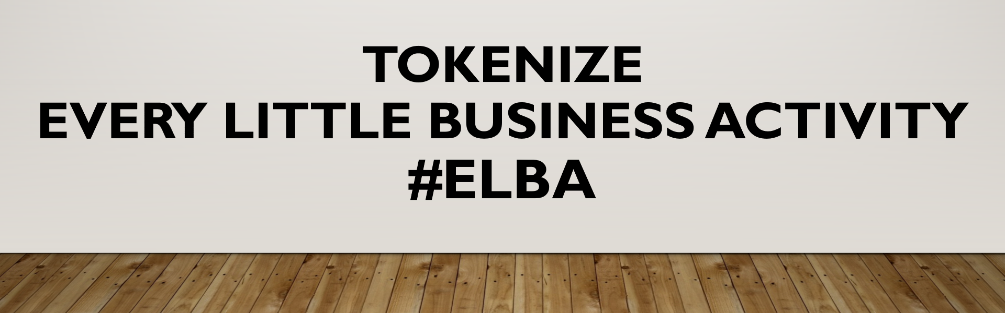
I leave you with a challenge… Think Deeply about NEO Smart Economy and …
Tokenize Every Little Thing (ELT)
https://hyperonomy.com/2018/01/24/tokenization-of-every-little-thing-elt/

Slide 12
Questions?
Michael Herman (Toronto) – Independent Blockchain Developer
G: https://github.com/mwherman2000/neo-csharpcoe E: mailto:neotoronto@outlook.com L: https://www.linkedin.com/in/mwherman/ M: https://www.meetup.com/NEO-Blockchain-Toronto F: https://www.facebook.com/neotoronto/ T: https://www.twitter.com/neotoronto

